Slide 1
BENCHMARK
#2
THE SLAB BOX

Slide 2
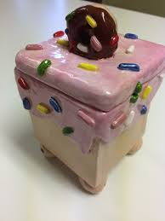
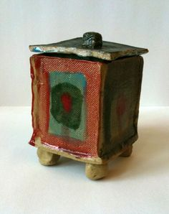
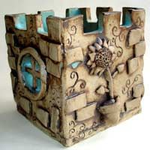
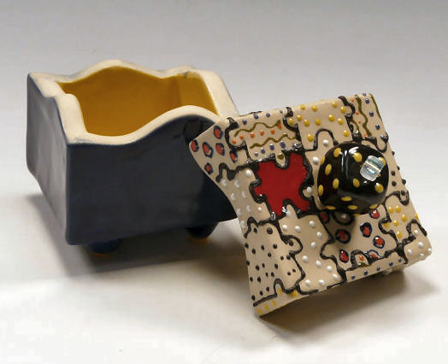

Slide 3
SECOND BENCHMARK PROJECT:
PERSONALIZED SLAB BOXES
FOR THIS PROJECT WE WILL BE LEARNING HOW TO:
MAKE AWESOME SLABS
SCORE AND SLIP SLABS TOGETHER AND SMOOTH OUT THE SEAMS
ADD AND SUBTRACT ITEMS TO THE SIDES OF SLABS
PAINT BISQUE WARE (CLAY THAT HAS BEEN FIRED ONCE) USING ACRYLIC PAINT (THE FINAL TOUCHES TO YOUR PERSONALIZED SLAB BOXES!)

Slide 4
For this project you will need:
Six 2”x2” slabs (5 for the box and 1 for the lid) *Make sure slabs are all the same thickness!
Invisible seams (smoothed out and filled in using COILS and tools)
2 sides with objects added so they are coming out (3D)
2 sides with objects subtracted so they are scratched in (2D)
1 LID: that has a small coil on the inside to secure the lid to the box
HANDLE: Something on top of lid to function as a handle
Footing: any style that goes along with your box to help prop it up off the table

Slide 5
Examples of LIDS, UNDERNEATH LID
and FOOTINGS
HANDLE = flower Simple Coil to Secure Lid Simple footing, but functions

Slide 6
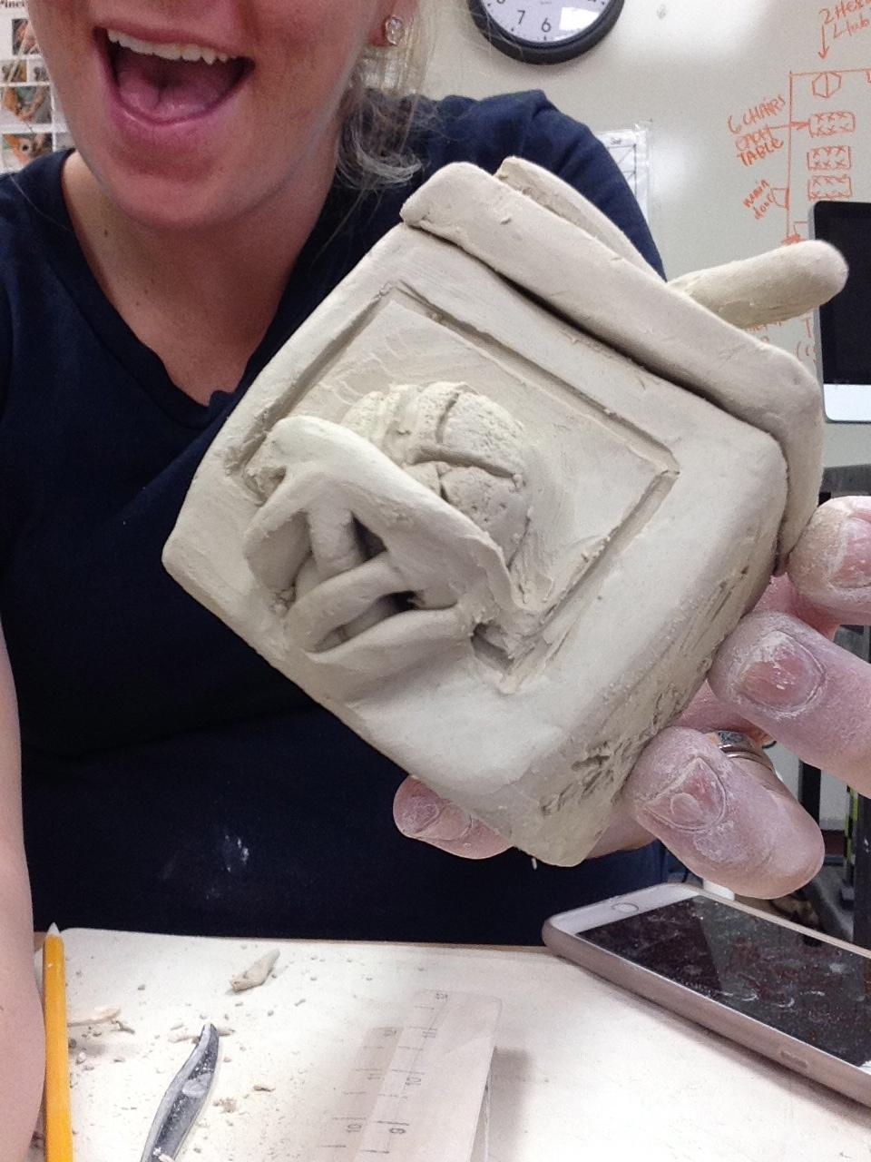
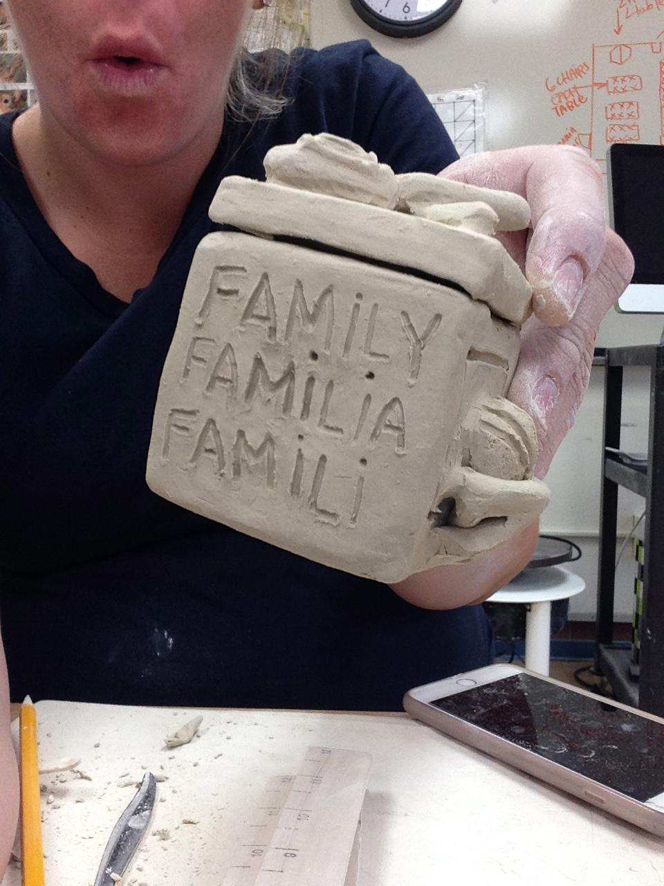
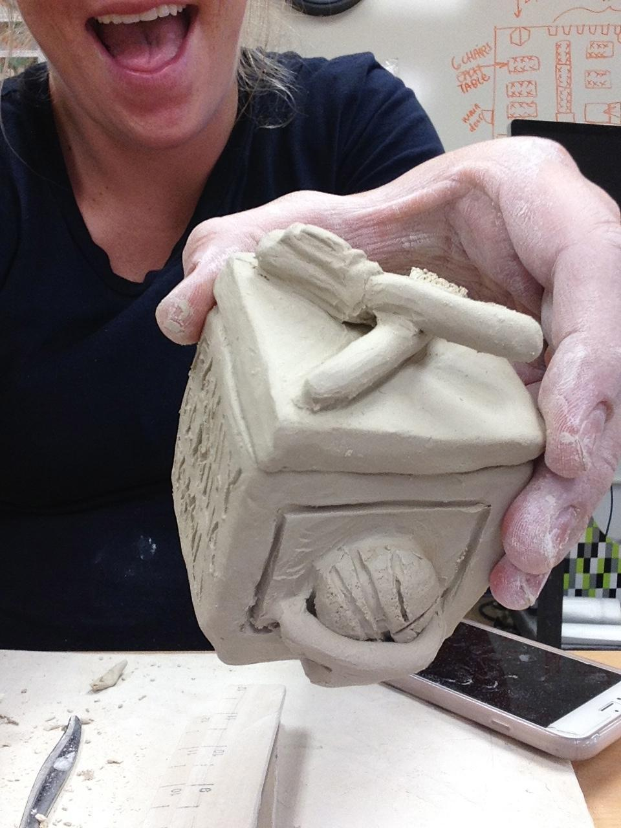
My Personalized Box Examples!!

